Slide 1
CEO Connections

Slide 2
AI infused mobile & desktop app development with .NET MAUI
David Ortinau | Product Manager Beth Massi | Product Manager Gerald Versluis | Engineer

Slide 3




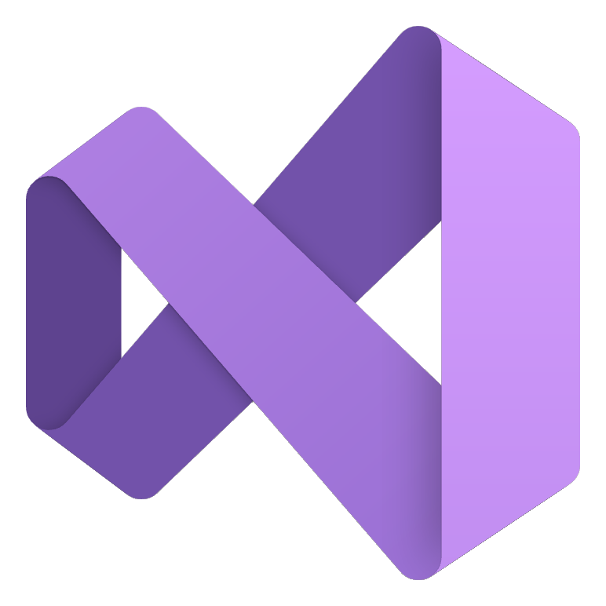


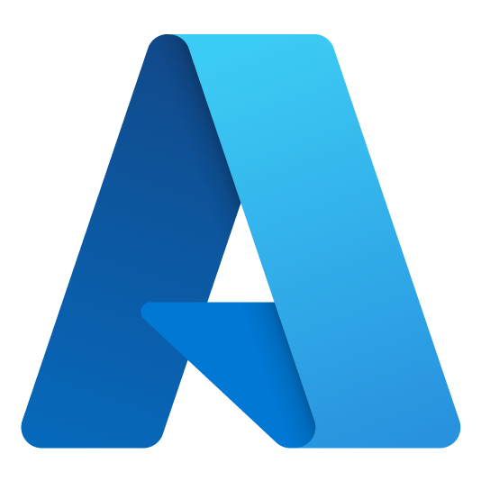
Build intelligent apps, intelligently
Agentic Apps
Agentic DevOps
Infuse AI into your .NET apps
AI-powered agents operating as a member of your dev team
Aspire
Build, test, and deploy seamlessly from code to cloud
Cloud
Web
Visual Studio
Visual Studio Code
Desktop
Mobile
GitHub
Azure
Games
IoT
Applications
Tools
Notes:
The .NET team builds the platform and integrates into the tools you need to build intelligent apps, intelligently. Whether that’s providing the essential building blocks as part of the .NET platform, providing C# SDKs and extensions for AI experiences, or connecting .NET developers to the entire ecosystem of LLMs to build Agentic Apps with .NET.
.NET also integrates into the Agentic DevOps lifecycle of tools that provide AI-powered Agents to help you write, test, modernize and upgrade code, as well as deploy the apps and keep them running smooth.
And .NET Aspire streamlines the development, testing and deployment of these complex systems.

Slide 4
“AI is introducing the third user-interface paradigm in computing history, shifting to a new interaction mechanism where users tell the computer what they want, not how to do it — thus reversing the locus of control.” Jakob Nielsen
Notes:
https://www.nngroup.com/articles/ai-paradigm/

Slide 5

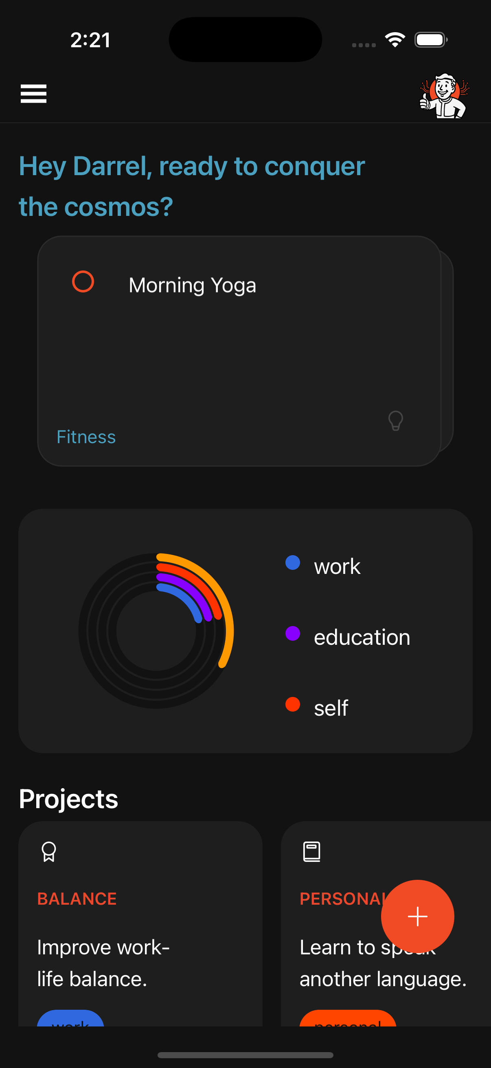
An AI-infused App
Notes:
This is how Microsoft is helping you to leverage AI to build the next generation of AI powered mobile and desktop applications.
On mobile we can do some pretty cool stuff. Let's look at what we have in our hands. We have location, a mic, a camera. We have personal info. We have calendar. All this can be used to greatly enhance any app experience, and in the hands of AI it's on a whole new level

Slide 6







AI is changing applications, and how we make them
Changes in User Experience
Personalization
Context-awareness
Multimodal interaction
Notes:
The more AI powered interfaces can build trust, the more they will be adopted
“AI delivers personalized, multimodal interactions and real-time UI adaptations” - Bieniek et al. (2024)
What do we need from an SDK to deliver this?
Support multimodal interactions
Incorporate explainability features
Enforce ethical safeguards
Offer adaptive UI components
“AI tools which facilitate rapid prototyping, creative augmentation, and collaborative design improve both project quality and ideation.”
“Businesses are urged to adopt models that emphasize collaborative human–AI partnerships and ethical integration to enhance application performance and user satisfaction.” Stige et al. (2023)
AI Assistance for UX: A Literature Review Through Human-Centered AI

Slide 7
6 Design Principles for AI Applications
Design for Appropriate Trust & Reliance
Design Responsibly
Design for Mental Models
Solve real user problems
Minimize user harms
Use human-centered design
Expose or limit emergent behaviors
Test & monitor for user harms
Orient the user to generative variability
Teach effective use
Understand the user’s mental model
Teach AI about the user
Help a user know when they should/should not rely on AI output
Be clear on how well AI performs for a given task
Provide rationales for outputs
Use friction to prevent overreliance
Encourage critical thinking
Signify the role of the AI
Design Principles for Generative AI Applications
Justin D. Weisz, Jessica He, Michael Muller, Gabriela Hoefer, Rachel Miles, Werner Geyer International Conference on Human Factors in Computing Systems 2024

Slide 8
6 Design Principles for AI Applications
Design for Generative Variability
Design for Co-Creation
Design for Imperfection
Leverage multiple outputs
Visualize the user’s journey
Enable curation & annotation
Draw attention to differences or variations across outputs
Help the user craft effective outcome specifications
Provide generic input parameters
Provide controls relevant to the use case & technology
Support co-editing of generated outputs
Make uncertainty visible
Evaluate outputs for quality
Offer ways to improve outputs
Provide feedback mechanisms
Design Principles for Generative AI Applications
Justin D. Weisz, Jessica He, Michael Muller, Gabriela Hoefer, Rachel Miles, Werner Geyer International Conference on Human Factors in Computing Systems 2024

Slide 9
Microsoft’s AI Principles
Fairness
Reliability & Safety
Privacy & Security
Inclusiveness
Transparency
Accountability
Notes:
Building trustworthy AI cannot be done without effective governance and at Microsoft, we believe effective AI governance starts at home. Since adopting our AI principles in 2018, we have been on the journey to uphold these principles in how we build and deploy AI

Slide 10
Mitigation Layers
User Experience
Design for responsible human-AI interaction
The HAX Toolkit is a set of practical tools to help create responsible and effective human-AI interactions, including guidelines, workbooks, design patterns, and a design library
System Message & Grounding
Ground your model and steer its behavior
Recommended System Message Framework provides instructions, clear directives, background information relevant to the task, guidelines on tone and style of responses, and safety guidelines
Safety System
Monitor and protect model inputs and outputs
Azure AI Content Safety detects and moderates harmful user-generated and AI-generated content in applications and services using text and image APIs
Model
Choose the right model for your use case
Azure AI Foundry model catalog provides a broad selection of models and helpful tools to guide your choice
Notes:
http://aka.ms/haxtoolkit
Through our work the past few years, with the growing surge of generative AI, we find that most AI applications require a mitigation plan across four layers of technical mitigations: (1) the model, (2) safety system, (3) system message and grounding, and (4) user experience layers.
The model and safety system layers are typically platform layers, where built-in mitigations would be common across many applications. They are built into Azure AI.
The next two layers largely depend on the application’s purpose and design, meaning the implementation of mitigations can vary a lot from one application to the next.
So again, while the foundation model you’re using is obviously an important component of the system, it's not the complete system.
We need to apply a combinations of mitigations across the platform and application.
Azure AI model catalog provides a broad selection of models and helpful tools to guide your choice
Identify the most promising models using search filters and model benchmarks
Review model cards to better-understand model details, costs, capabilities, and limitations
Review security verifications for scanned models
Run manual and automated evaluations to assess the quality and safety of model outputs
There are three types of filters offered by Azure AI Content Safety.
We provide configurable content filters for harmful content, like text and imagery containing violence or hate speech, which you can adjust by severity level. These are always set to a medium threshold by default.
Customers can also create their own custom content filters using small training datasets.
Prompt shields are detection models that can be turned on for model inputs, to detect when a user is trying to attack or manipulate the AI system into doing something outside it’s intended purpose or design.
Lastly, we have detection models that can be turned on to flag other kinds of risky inputs or outputs, such as protected or copyright material or code, or hallucinations, where the model output does not align to the source material provided.
Customers can also create custom blocklists to filters specific terms in inputs or outputs.
A recommended system message framework for Azure AI includes several key components:
Instructions: Clear directives on how the AI should behave, such as avoiding harmful content and respecting copyright laws.
Context: Background information relevant to the task or user interaction.
Tone: Guidelines on the tone and style of responses, ensuring they are appropriate for the audience.
Safety Guidelines: Specific rules to mitigate risks, such as checking grounding data before responding.
Tools: Instructions on using additional tools or APIs to enhance responses
The HAX Toolkit is a set of practical tools designed to help teams create responsible and effective human-AI interactions, including guidelines, workbooks, design patterns, and a design library

Slide 11
Resources for getting started
Microsoft’s approach foundations
2024 Transparency Report
Responsible AI Tools and Practices | Microsoft AI
Responsible AI Standard v2
Responsible AI Impact Assessment Template
Azure AI to help you build more secure and trustworthy generative AI applications
Special topics
Planning red teaming for large language models (LLMs)
Microsoft’s open automation framework to red team generative AI Systems
Lessons from Red Teaming 100 Gen AI products whitepaper
HAX Playbook for human-AI interaction design
Customer Copyright Commitment Required Mitigations
Accelerating Sustainability with AI: A Playbook
Learning modules
Microsoft AI - Learning and Community Hub
Embrace responsible AI principles and practices - Training
Fundamentals of Responsible Generative AI – Training
Responsible generative AI in AI Studio – Training
AI Red Teaming Learning hub
AI Literacy Starting Guide
Microsoft on the Issues
How do we best govern AI?
Our commitments to advance safe, secure, and trustworthy AI
Microsoft announces new Copilot Copyright Commitment
Combating AI deepfakes in elections through today’s new tech accord
Protecting the data of our commercial and public sector customers in the AI era
Global Governance: Goals and Lessons for AI
Innovating in line with the European Union’s AI Act
Find resources like these and more at aka.ms/RAI
Notes:
Here are some of the resources we’ve made available, whether you are just getting started or looking to build and mature your responsible AI practices

Slide 12
.NET MAUI is Infusion Ready

Slide 13
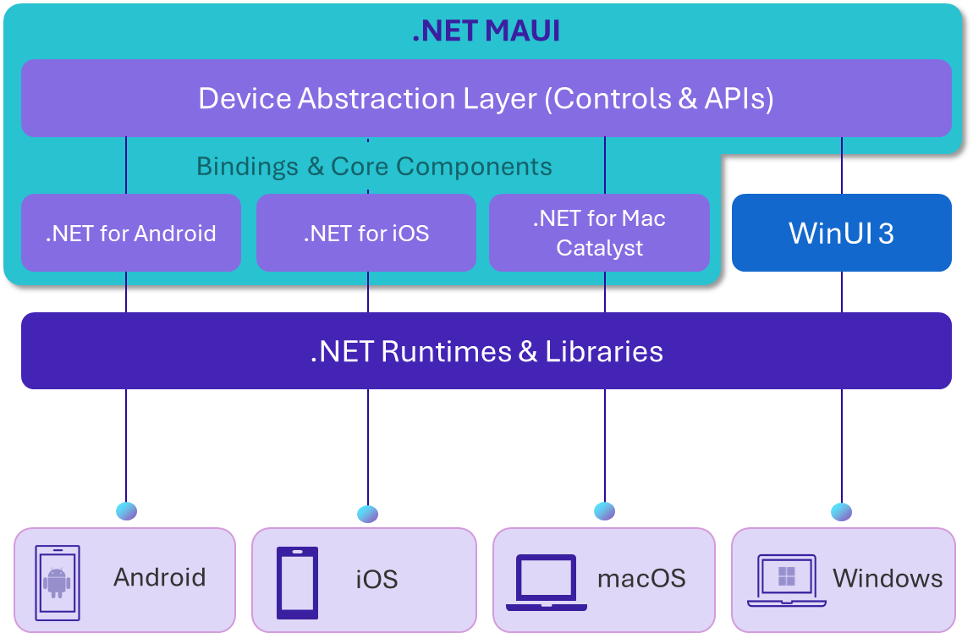
.NET MAUI
github.com/dotnet/maui
Build native, multi-platform apps all in one framework.
Modern native client stack for .NET
Single project, single codebase
Native controls and styling
Access over 60 common device APIs
Access platform specific APIs if needed
App store distribution and reach
Productivity for Visual Studio and VS Code
Platform is open source on GitHub
Healthy ecosystem of controls and components
Notes:
.NET MAUI provides all the bindings and core components you need to target Windows, macOS, iOS and Android. It also includes the device abstraction layer providing you one set of controls and APIs. Access over 60 device APIs like storage, networking, and device specific sensors and capabilities with the same code. And if needed, you can access platform-specific APIs easily.
Because it’s built on top of .NET, you have full access to the .NET Base Class Libraries, unified build system, and productivity tooling you know and love like Visual Studio and VS Code. The .NET MAUI controls, APIs and core components are open source on GitHub, and there’s a healthy ecosystem of third-party controls and components, just like you would expect from .NET.

Slide 14
.NET MAUI NOW
+17%
1.5k
1.2k
YoY Developers
Issues Resolved Since 9 GA
PRs Merged Since 9 GA
-26%
4.7x
1.4x
Issues Created Last 4mo YoY
PRs Created Last 4mo YoY
PRs Merged Last 4mo YoY
Notes:
.NET 9 GA was November 2024
Year over Year (YoY): January – April 2025 compared to January – April 2024

Slide 15

One solution, everything you need
Context-awareness
Multimodal
UI Controls
Location
Calendar
Contacts
Time
Biometrics
Sensors
Text
Voice
Vision
ActivityIndicator
BlazorWebView
Border
BoxView
Button
CarouselView
CheckBox
CollectionView
ContentView
DatePicker
Editor
Ellipse
Entry
GraphicsView
HybridWebView
Image
ImageButton
IndicatorView
Label
Line
Map
Path
Picker
Polygon
Polyline
ProgressBar
RadioButton
Rectangle
RefreshView
RoundRectangle
ScrollView
SearchBar
SkiaSharp
Slider
Stepper
SwipeView
Switch
TimePicker
TwoPaneView
WebView
Adaptive UI
Model Support
App Theme Manager
Data binding
Visual State Manager
Templated layout
Adaptive Triggers
Azure AI Foundry
Open AI
Ollama
ONNX
AI
Open AI
Microsoft.Extensions.AI
Semantic Kernel
Model Context Protocol
Tool calling
Vector search

Slide 16
Microsoft.Extensions.AI
ChatClientServices.cs
_chatClient = new OpenAIClient(apiKey)
.GetChatClient(model: model)
.AsIChatClient();
_chatClient = new ChatClientBuilder(_chatClient)
.Build();

Slide 17
MCP and Tool calling
ChatClientServices.cs
_chatClient = new OpenAIClient(apiKey)
.GetChatClient(model: model)
.AsIChatClient();
_chatClient = new ChatClientBuilder(_chatClient)
.ConfigureOptions(options =>
{
options.Tools ??= [];
options.Tools.Add(AIFunctionFactory.Create(_locationTools.IsNearby));
})
.UseFunctionInvocation()
.Build();

Slide 18
Tool calling
LocationTools.cs
[Description("Checks if the user is near a location or business type")]
public async Task<string> IsNearby(
[Description("Type of location (e.g. coffee shop, Target, grocer)")]
string pointOfInterest,
[Description("Distance threshold in meters (default: 100)")]
double distanceThresholdMeters = 100)
{
// use Map.APIs to get nearby locations
}

Slide 19
Bring it all together – Analyze & Prioritize Tasks
MainPageModel.cs
var apiResponse = await chatClient.GetResponseAsync<PriorityTaskResult>(prompt);
if (apiResponse?.Result != null)
{
if (!string.IsNullOrEmpty(apiResponse.Result.PersonalizedGreeting))
{
PersonalizedGreeting = apiResponse.Result.PersonalizedGreeting;
}
// do more
}

Slide 20
Plugin.Maui.Audio
VoicePageModel.cs
_recorder = _audioManager.CreateRecorder();
await _recorder.StartAsync();
_audioSource = await _recorder.StopAsync();
await using (var fileStream = File.Create(audioFilePath))
{
var audioStream = _audioSource.GetAudioStream();
await audioStream.CopyToAsync(fileStream);
}

Slide 21
MediaPicker
PhotoPageModel.cs
result = await MediaPicker.CapturePhotoAsync(
new MediaPickerOptions
{
Title = "Take a photo"
}
);
using Stream sourceStream = await result.OpenReadAsync();
using FileStream localFileStream = File.OpenWrite(ImagePath);

Slide 22
Project dependencies
Libraries
Syncfusion Toolkit for .NET MAUI
CommunityToolkit.Mvvm
CommunityToolkit.Maui
Microsoft.Extensions.AI
Microsoft.Extensions.AI.OpenAI
Microsoft.Maui.Controls
Plugin.Maui.Audio
Plugin.Maui.CalendarStore
SkiaSharp
BottomSheet
CardView
EffectsView
Expander
PullToRefresh
SegmentedControl
Shimmer
TextInputLayout
Notes:
A big part of what makes .NET MAUI apps so beautiful/powerful/easy to make is the fantastic contributions from our partner Syncfusion. To tell you more about that, please help me welcome Uma Chandrabose, Senior Product Manager at Syncfusion, to give us an update.

Slide 23
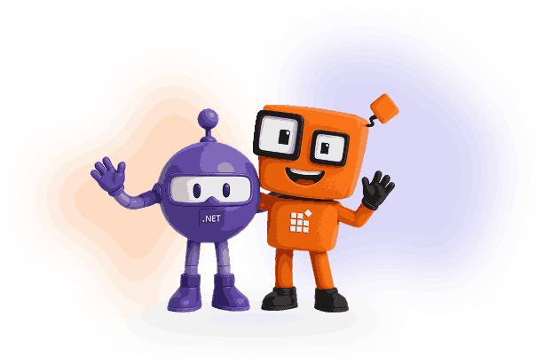
Syncfusion + Microsoft: Empowering Developers Together

Slide 24


About Me
Uma Maheswari Chandrabose
Senior Product Manager, Essential Studio
Syncfusion
https://www.linkedin.com/in/uma-maheswari-chandrabose

Slide 25
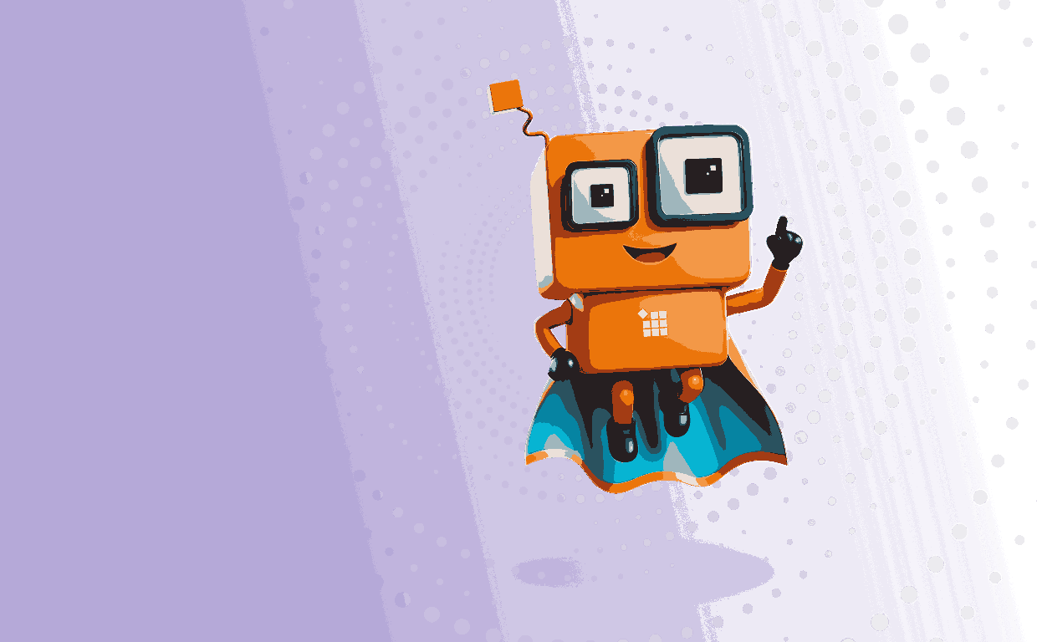
Syncfusion
A comprehensive suite of 1900+ UI Controls across different frameworks
Quickly build mobile, web, and desktop apps

Slide 26
How Syncfusion is Collaborating for Dev Community
Growing with .NET ecosystem

Slide 27
Microsoft Collaboration
Advance .NET MAUI framework
Contributing to the community in 2 ways
Syncfusion Toolkit for .NET MAUI
.NET MAUI framework repository

Slide 28
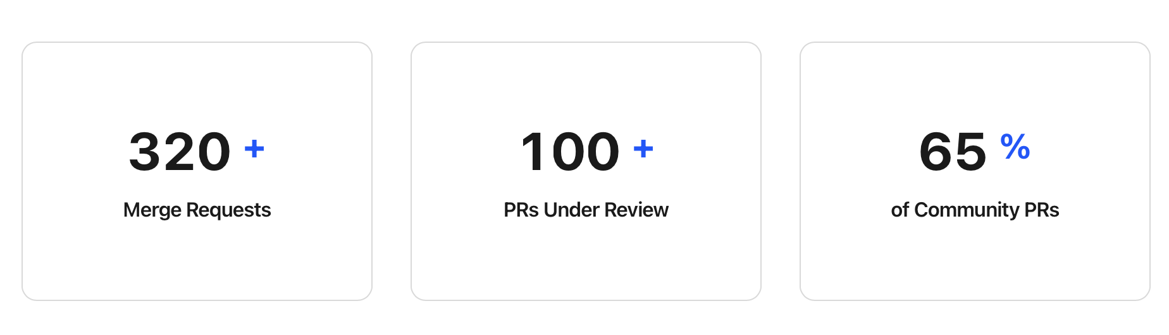
Microsoft Collaboration
.NET MAUI Framework Repository

Slide 29
Impact of Collaboration
Speed up development – high quality and compatible
Get to know more about the community requirements.
Test our controls in beta version of .NET MAUI before the official release.
Huge spike in .NET MAUI Toolkit

Slide 30
New Updates to Syncfusion Toolkit for .NET MAUI
6 new controls for .NET MAUI Toolkit
1. Pickers – Picker, Date Picker, Time Picker, DateTime Picker
2. Progress bar – Linear, Circular
Optimized for AOT and Trimming
Your apps stay fast and light

Slide 31
Final Note
Simplify development and deliver innovation with ease
AI-powered UI components

Slide 32
Thank you!
Do visit our website syncfusion.com for more details!
Notes:
Thanks Uma! Now let’s have Beth Massi show us how you can also use beautiful controls from Syncfusion both on the web and in .NET MAUI.

Slide 33
.NET MAUI Hybrid Apps

Slide 34
What are hybrid apps and why build them?
01
Blend of native and web technology: UI is written using web technologies such as HTML, CSS, and JavaScript wrapped in a native app container.
04
Reach via app store distribution: hybrid apps are native apps that can be downloaded and installed through the app stores.
02
Access to native platform features and device hardware: leverage native platform features and device hardware that a web application cannot access easily or even at all.
05
Code reuse across device platforms and web browsers: achieve greater developer productivity via code reuse across devices and web browsers.
03
Can be mobile and/or desktop devices: run on multiple device platforms without the need for completely separate development.
Notes:
Hybrid apps are a blend of both native and web solutions. The core UI of the application is written using web technologies such as HTML, CSS, and JavaScript. These apps are then wrapped in a lightweight native app "container" that allows them to leverage certain native platform features and device hardware (like a device's camera, calendar, push notifications, and pinch and spread functionality) that a web application cannot access easily or even at all.
This approach allows hybrid apps to run on, for example, both iOS and Android platforms without the need for completely separate development. And they can be downloaded and installed through the app stores. The main advantage of hybrid apps is that they can achieve greater developer productivity via code reuse across devices and web browsers.
A couple examples are Electron for desktop apps and Ionic for mobile apps.

Slide 35
Web UI and Native UI
Look and feel
Web UI typically looks the same across devices (controlled by CSS), while Native UI typically provides device-specific look & feel by default
UX
Native UI can provide more seamless user experiences tailored to the specific devices
Code reuse
Web UI can easily be reused in a web app
Skillset
Web UI requires knowledge of HTML, JavaScript, CSS, while Native UI (on the Microsoft stack) requires knowledge of XAML
Notes:
So why choose Web UI over Native UI or vice versa?
The look and feel and user experience can be a factor here. Native UI can provide device-specific look and feel as well as more seamless user experiences tailored to the specific device platforms. Web UI look-and-feel looks typically the same across devices (controlled by CSS).
If you are less concerned about look and feel and you want or need to target web browsers, Web UI is probably the better option as it allows you to easily reuse UI across native and web apps. In addition, you may already have a web app and you want to reuse existing assets UI you’ve already built.
Particularly for business apps though, it all comes down to skillset and what you’re more comfortable with.

Slide 36

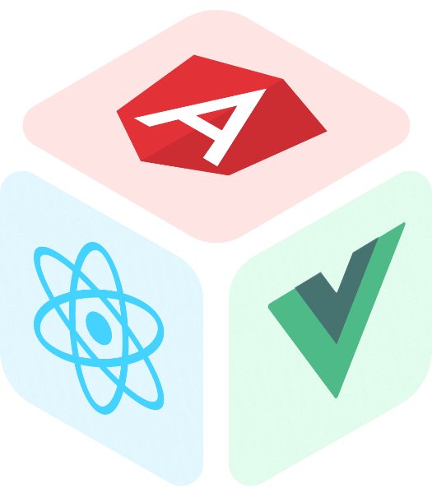
.NET MAUI Hybrid Apps
Hybrid apps with Blazor
Solution template for Blazor Hybrid+Web
Tight inner loop with Copilot and Hot Reload
Built-in input controls, validation, forms, auth
Hybrid apps with other JavaScript frontends
Reuse Angular, React, etc. investments in MAUI native desktop and mobile apps
Provides C# to JavaScript interop
New hooks for intercepting web requests in .NET 10 (P5)
Notes:
We’ve added even more value to MAUI hybrid apps. In .NET 9 we’ve continued investment in Blazor hybrid. But we also added a new control, HybridWebView. This will allow you to use other JavaScript frontends within MAUI native apps, like React, Angular, and Vue. The control renders your JavaScript frontend in a native container and facilitates communicating between C# and JavaScript. In .NET 10 we’re adding more fine-grained methods to both the HybridWebView and BlazorWebview so you can handle events related to web requests and responses. We’re also doing some fit-and-finish work on HybridWebView that we didn’t get to in .NET 9 like packaging the HybridWebView.js into the NuGet package so it applies to your apps automatically.

Slide 37
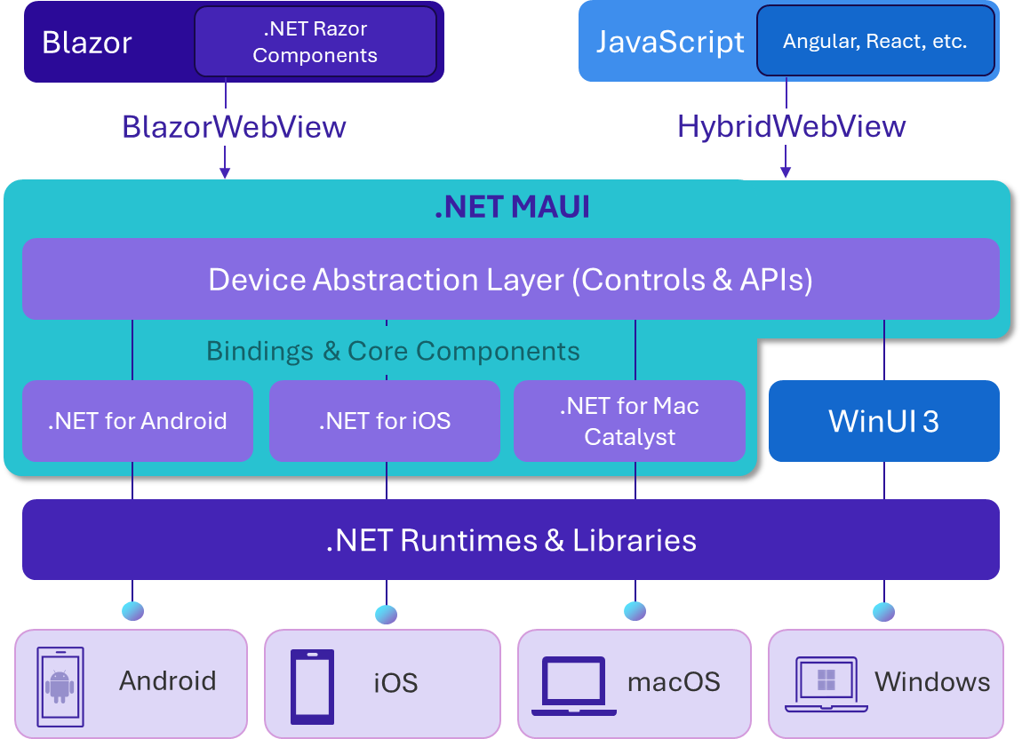
.NET MAUI Hybrid Apps
github.com/dotnet/maui
Build native, multi-platform apps with web UI.
Native app container & embedded controls
Fully native web UI through platform WebView
No internet required; web assets packaged with app
Multi-platform with MAUI abstractions
App store distribution and reach
Easily reuse web UI across MAUI native and Blazor web apps with new Solution template
Support for Blazor and other JavaScript frameworks like Angular, React, Vue, etc.
Notes:
With .NET MAUI, Blazor apps can also run natively on devices. This means you can create hybrid client apps, which combine Blazor & MAUI components together into a single NATIVE client application, giving you full access to the native platform capabilities.
Blazor hybrid relies on .NET MAUI for a native application container and native controls, if you want to use them. So you could even mix Web UI with Native UI if you want.
Blazor hybrid apps are built on top of .NET MAUI. You host Blazor components which the BlazorWebview control with derives from the native platform’s WebView. No internet is required, UI is packaged with the app. And you can use all the built-in input controls, validation, forms, and auth flows that Blazor provides right out of the box. This makes it easier to share UI across native and web hosting models. In fact, we provide a solution template for quickly setting up a MAUI Blazor hybrid app and a Blazor web app that shares all of its UI with the maui-blazor-web template.
Blazor hybrid apps have full access to the MAUI abstractions and the native devices. This makes it easy to do native things that can be difficult or impossible on the web alone. You can do things like call native API's, access the file system, make phone calls, format the c: drive! Don’t do that, but you get my point!
It also gives you the ability to take your apps and package them for store distribution and reach whether that’s the Microsoft, Apple or Google App stores.
And starting with .NET 9, MAUI has a HybridWebView control that will allow you to use other JavaScript UIs in MAUI too. Take your Angular, React, Vue, or any other HTML/JS-based UI and package that with your MAUI app. The control provides interop between C# and JavaScript so you can keep your business logic and native device access in C# but your UI can leverage existing JavaScript assets you probably already have.

Slide 38
Reusing UI across native and web with Blazor
Web
Native
Blazor web app
MyApp.Web
MAUI hybrid app
MyApp.MAUI
Shared UI & Interfaces
Razor class library
MyApp.Shared
.NET
Razor Components
Notes:
One of the biggest benefits of hybrid apps is being able to reuse your UI across your native and web apps. If you also want to target web browsers, you can structure your solution to maximize code reuse using a shared Razor Class Library that houses the shared UI as well as interfaces for the functionality you want to use from the UI. The implementations of these are then defined in the specific Blazor Web and MAUI projects. This is because sometimes you need to write different code for the different hosting models. This gives you a clean way to do that.

Slide 39
DEMO: .NET MAUI Blazor Hybrid and Web

Slide 40
Agentic DevOps

Slide 41
Evolving DevOps
DevOps
DevSecOps
Agentic DevOps
“Union of people, process, and technology to enable continuous delivery of value to end users.”
“Union of people, process, and technology with security as a shared responsibility to enable continuous delivery of value to end users.”
AI-powered agents operating as a member of your dev team to automate, optimize, and accelerate every stage of the software development lifecycle.
Notes:
But as app development becomes more complex, new tools are emerging to help developers keep up with increasing demands.
In the past, we already saw the evolution from traditional DevOps to DevSecOps—a transformation that saw the purview of DevOps expand from unifying people, processes, and technologies across the software development lifecycle, to one that treats security as a shared responsibility as well.
Now, AI-powered agents are emerging as meaningful contributors to software development. And while AI capabilities have historically been limited to helping developers code, we are witnessing rapid growth in the technology.
At Microsoft, we believe these intelligent agents hold the key to a new stage in DevOps evolution—Agentic DevOps. By expanding the capabilities of AI, we believe software development teams will be able to automate, optimize, and accelerate every stage of the software development lifecycle.

Slide 42
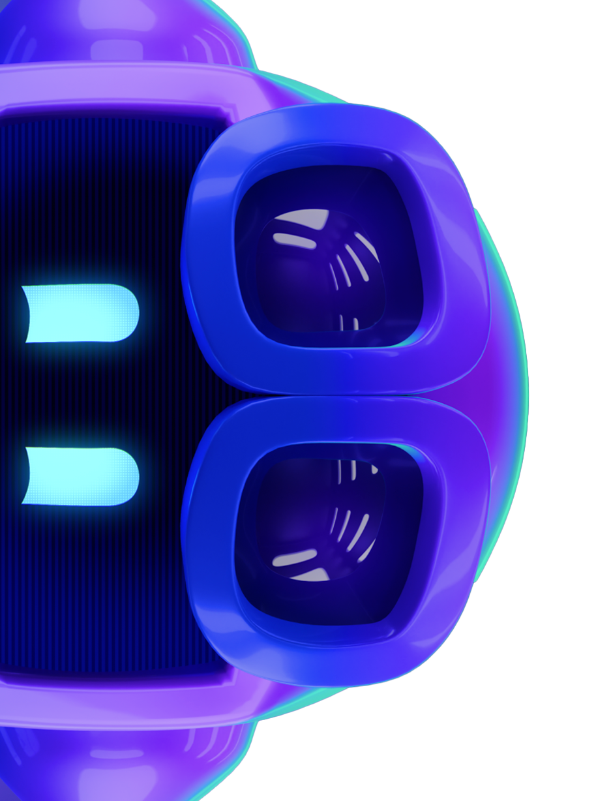
GitHub Copilot is built for developer experience
Automate the mundane and focus on what matters
Experiences
Sense making (summarization, code understanding)
Writing code
Writing tests, documentation
Debugging code
Reviewing code
Fixing bugs and vulnerabilities
Upgrading dependencies
Code modernization, refactoring
Updating stakeholders
Notes:
These are all cool things that you can do with Copilot… explain a piece of code, code reviews… Write DOCS! Right?! At least you don’t have to spend any more time to writing docs that no one will read… and you can also apply that to the things we have just seen and make your developer experience even better.
We are continuing to build out GitHub copilot specifically to support the developer experience. Our goal is for GitHub Copilot to help automate the mundane so developers can feel empowered to focus on what matters.

Slide 43
Ideation
Planning
Model evaluation
The next evolution of GitHub Copilot
AI assisted coding
Testing
New agents help solve real-world problems throughout the software lifecycle
Code review
Security
Deployment
Modernization
Notes:
Software development doesn’t stop with coding. And that’s why we’re excited for the next evolution of GitHub Copilot, with new agents that can help solve real-world problems throughout the software lifecycle.
Land the message that this is an evolution of GitHub Copilot. That this is a massive expansion of how the world knows GHP and that we’re now bringing the power of AI across the end to end lifecycle.

Slide 44
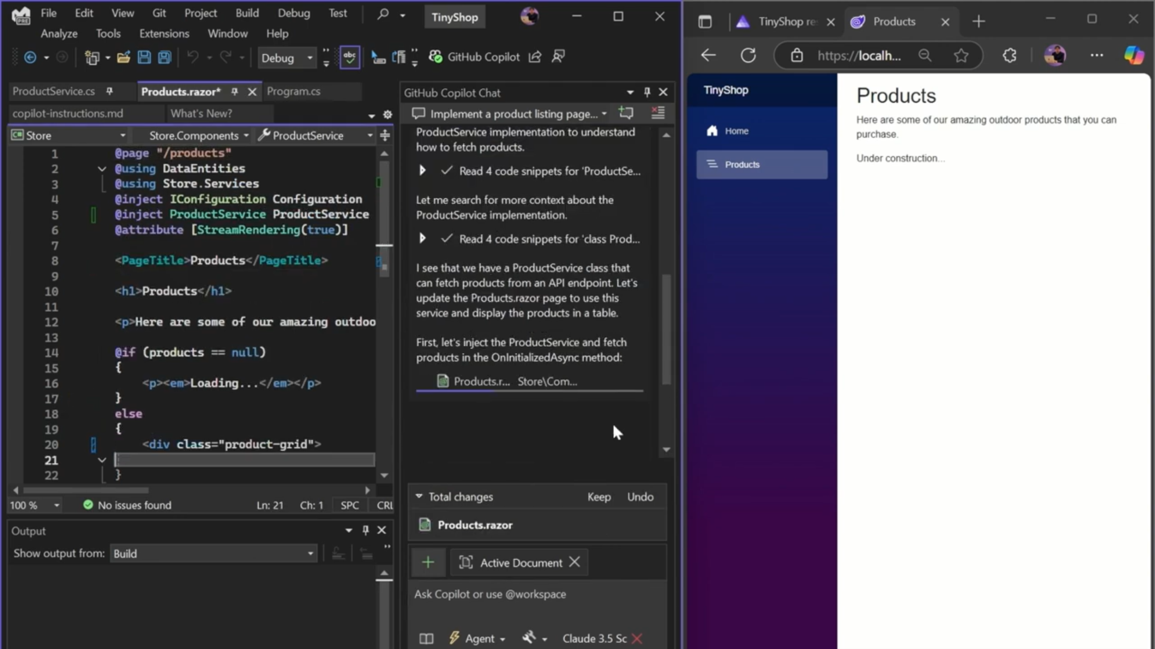
Agent Mode
GitHub Copilot
Supercharge the AI-assisted coding experience directly in Visual Studio
Expand your AI capabilities beyond autocomplete by assigning multi-step coding tasks directly from your IDE
Leverage an AI-powered peer programmer that can build new features, refactor legacy code, and heal itself when things break
Analyze a codebase, edit files, run tests, fix errors, and suggest terminal commands—all from a single prompt
Use agent mode in the IDE of your choice with support for Visual Studio and Visual Studio Code + more
Notes:
GitHub Copilot agent mode supercharges the AI-assisted coding experience to become a true peer programmer.
Acting alongside developers in their IDE, agent mode can build features, refactor legacy code, and even heal itself when things break.
It goes far beyond autocomplete to help developers analyze a codebase, edit across multiple files, run tests, fix errors, and suggest terminal commands, all from a single prompt.
Available in VS Code and Visual Studio today, agent mode is expanding to new IDEs, including JetBrains, Eclipse, and Xcode with public preview support announced at Build 2025.

Slide 45
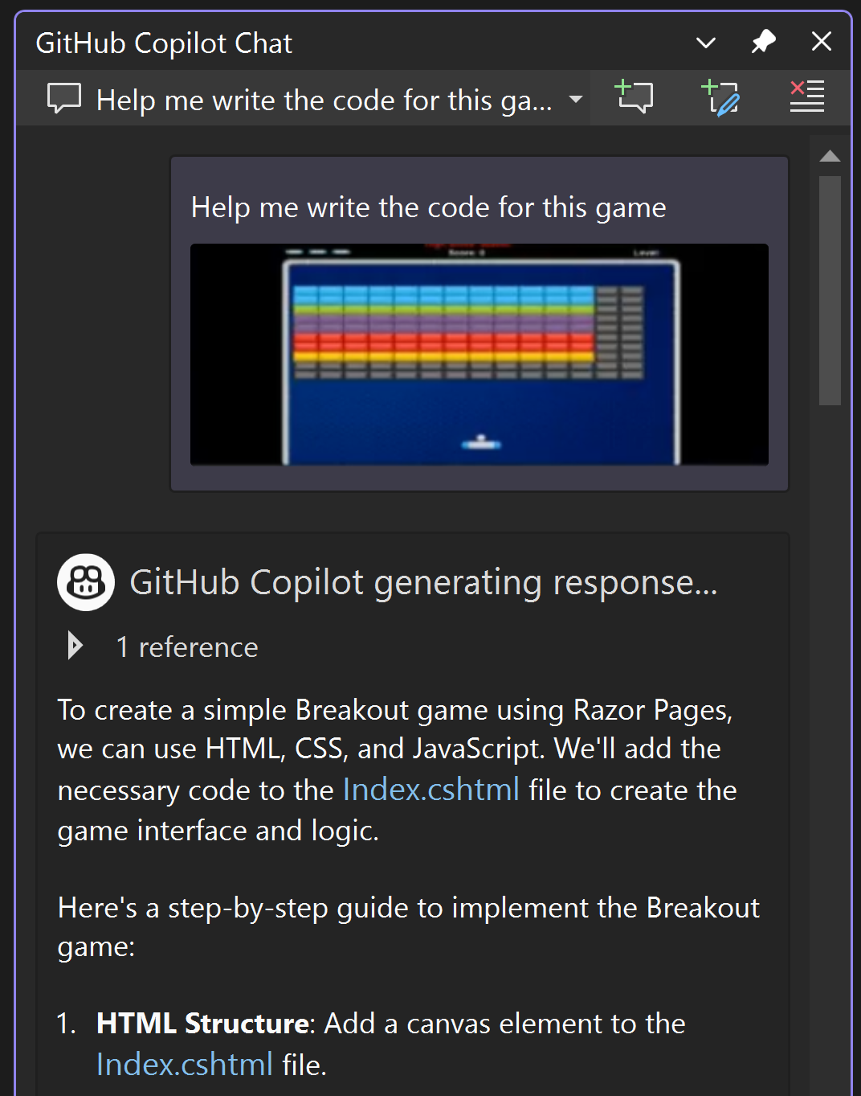
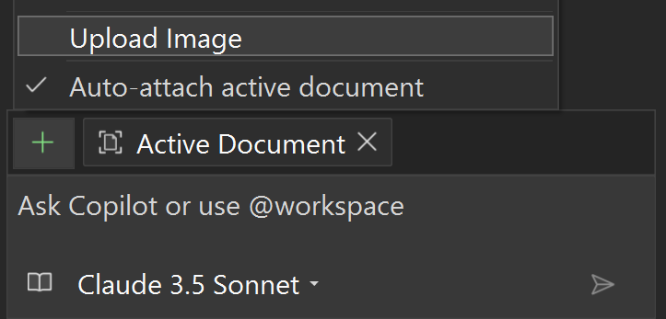
Copilot Vision
GitHub Copilot
Illustrate your context with images instead of text in Visual Studio
Copilot interprets UI designs and specs, redlines and annotations, project architecture diagrams, data schemas, even napkin sketches
Together with hot reload and live preview, watch your UI designs come to life
Provides the latest multi-modal LLM improvements in Visual Studio

Slide 46
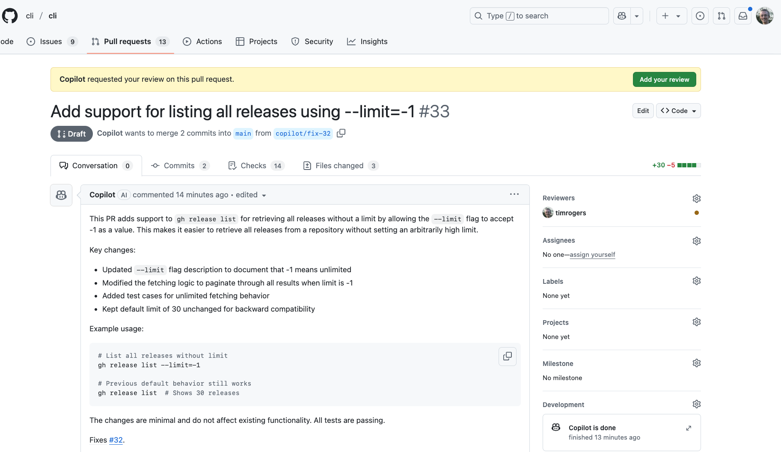
Coding Agent
GitHub Copilot
Agentic capability in GitHub to enhance team productivity like an AI teammate
Assign issues to GitHub Copilot and get back pull requests, automatically validated with tests and linters
Stay in control by working with Copilot just like any other developer and iterating through pull request reviews
Tailor Copilot to your needs by customizing its dev environment, adding custom instructions, and providing external context through MCP servers
Notes:
Developers can now assign GitHub Copilot a range of development tasks from autonomously refactoring code, improving test coverage, and upgrading dependency to fixing defects and implementing new features.
For complex tasks, GitHub Copilot can even collaborate with other agents across all stages of the software lifecycle. Operating as a member of the development team, GitHub Copilot relieves developers of routine tasks to focus developers on more impactful tasks.

Slide 47
Demo: Intelligent Productivity
Copilot Agent, Vision, and Live Preview

Slide 48




.NET Aspire
Code-first control
Modular & extensible
Observability from the start
Flexible deployments
Notes:
Aspire gives you…
Code-first control - Define your stack in code — no YAML. Aspire launches locally, then shifts to real cloud services without changing your architecture. Dev and deploy, fully wired.
Modular and extensible - Orchestrate your existing stack — frontends, APIs, containers, databases, and more — without rewriting or replatforming. Extend Aspire for anything.
Observability from the start - Logs, traces, health checks — all local, all wired up automatically. OpenTelemetry included with zero setup.
Flexible deployments -Ship it how you want — to Kubernetes, your own infra, or managed services. Aspire adapts to your environment, not the other way around.
And you get a robust developer dashboard that you can use to build, visualize and debug all of this locally.

Slide 49
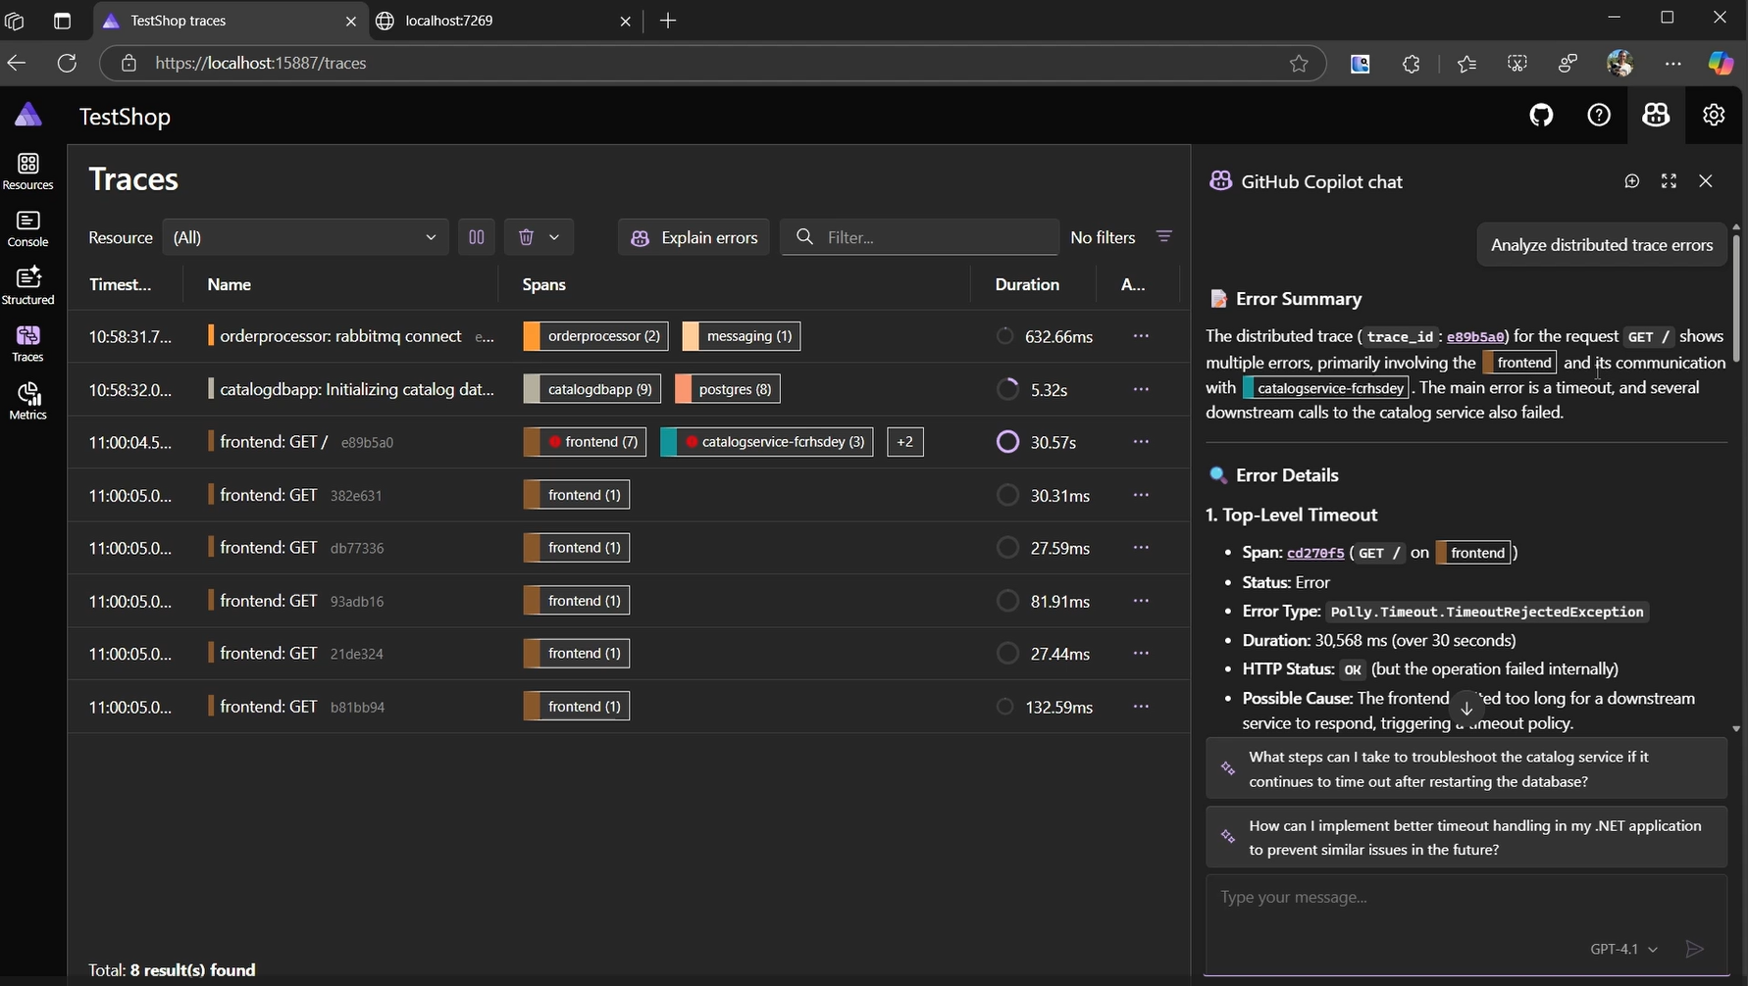
Aspire with Copilot
AI-assisted experience directly in the Aspire developer dashboard
Have Copilot identify resource issues, find bottlenecks, and help with spotting problems at development time
Ask Copilot about specific traces and find root causes of errors
Works seamlessly with the rest of your Copilot agents in Visual Studio

Slide 50
Demo: Aspire and .NET MAUI

Slide 51
Recap

Slide 52
Learn more
Related sessions
Microsoft AI Principles
aka.ms/RAI
.NET MAUI
github.com/dotnet/maui
Microsoft.Extensions.AI
github.com/dotnet/extensions
Syncfusion Toolkit
github.com/
.NET MAUI Hybrid Apps
aka.ms/maui-hybrid-docs
.NET MAUI Hybrid Lab
aka.ms/build-lab305
DEM520 • Powering local AI development with .NET Aspire May 19 11:35-11:50 AM Pacific
COMM443 • Table Talks: Building multiplatform apps with .NET MAUI
May 19 4:00-5:00 PM Pacific
COMM411 • Conversations: Let's Talk .NET Aspire
May 20 11:45-12:30 PM Pacific
BRK101 • The Future of .NET App Modernization Streamlined with AI​
May 20 3:00-4:00 PM Pacific
BRK115 • Python Meets .NET: Building AI Solutions with Combined Strengths
May 20 4:30-5:30 PM Pacific
BRK106 • Elevating Development with .NET Aspire: AI, Cloud, and Beyond May 21 2:00-3:00 PM Pacific
BRK123 • AI infused mobile & desktop app development with .NET MAUI
May 22 10:00-11:00 AM Pacific
Notes:
.NET

Slide 54
Thank You!
David Ortinau | david.ortinau@microsoft.com Beth Massi | bethma@microsoft.com Gerald Versluis | gerald.versluis@microsoft.com

